Slide 1
DBMS Ch:01 Introduction to DBMS concepts Mrs. Hezal Lopes

Slide 2
Outline
Basic Definitions
Types, Characteristics, Applications of Database
Simplified database system environment
Advantages & Disadvantages of DBMS over File System
Database Users
Database Architecture
Data Independence
Database Administrator

Slide 3
Data
Information
Data base
DBMS

Slide 4
Basic Definitions
Data: unrelated/ isolated facts-entity
Known facts that can be recorded and have an implicit meaning.
Such as : Text, numbers, images, audio, video
Eg. 25, ”ABC”
Information : Meaningful and useful data
It is processed data on which decisions and actions are based.
Eg. “The age of ABC is 25”

Slide 5
Basic Definitions
Database:
A collection of related data.
Database Management System (DBMS):
A software package/ system to facilitate the creation and maintenance of a computerized database.
Software that update, add, remove
Eg: College Management System

Slide 6
Why Data base?
Attendance – Result Analysis –Whole College Data
Business small-paper
Grow- DBMS
No matter small ,big organization, club, government- DBMS

Slide 7
Features of Data in Data base
It is well organized
Data is related
It is stored only once
Many users can access data without difficulty

Slide 8
Types of Databases
Centralized database.(Central library)
Distributed database. (data is distributed among different database systems of an organization)
Personal database.
End-user database.(real time database)
Commercial database.(massive amount of data)
NoSQL database.(not in tabular form)
Relational database(rows(tuple) and columns(attributes), and together forms a table(relation).)

Slide 9
Characteristics of Database Management System
Provides security and removes redundancy
Self-describing nature of a database system
Insulation between programs and data abstraction
Support of multiple views of the data
Control of data redundancy
Enforcement of integrity constraints
Restriction of unauthorized access
It follows the ACID concept ( Atomicity, Consistency, Isolation, and Durability).
DBMS supports multi-user environment that allows users to access and manipulate data in parallel.

Slide 10
Data Security & Remove Redundancy
Protects the data base against accidental or intentional loss, destruction or misuse.
Data in the database – given to only authorized user- modify the data.
Data is not stored in more than one location.
Repetition of data can be avoided

Slide 11
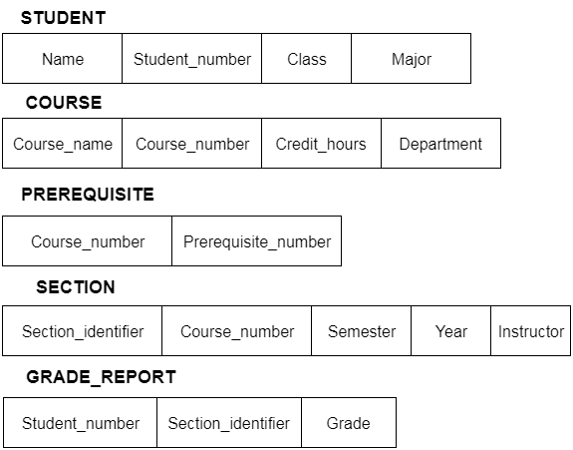
Self-describing nature of a database system

Slide 12
Data integrity constraints
Ensure that changes made is database by authorized users that do not result in loss of data consistency and correctness.
Concerned with correct and complete data.
Eg for incorrect data:
Employee assigned with non existing dept.
Inconsistency lead to system failure.

Slide 13
Data Independence
The capacity to change the data kept at one place without changing data kept at other locations.
Whats app and whats app database.
Change Features in database not in application.

Slide 14
Transaction control- Rollback
Changes made in the database can be reverted back with the help of rollback command.
Changes can be saved successfully with the help of commit command.

Slide 15
Concurrency Control
Data in database can be accessed by multiple users at same time.

Slide 16
Data Recovery- Back up and Restore
Is the process of resorting the database to original (correct) state after database failure.

Slide 17
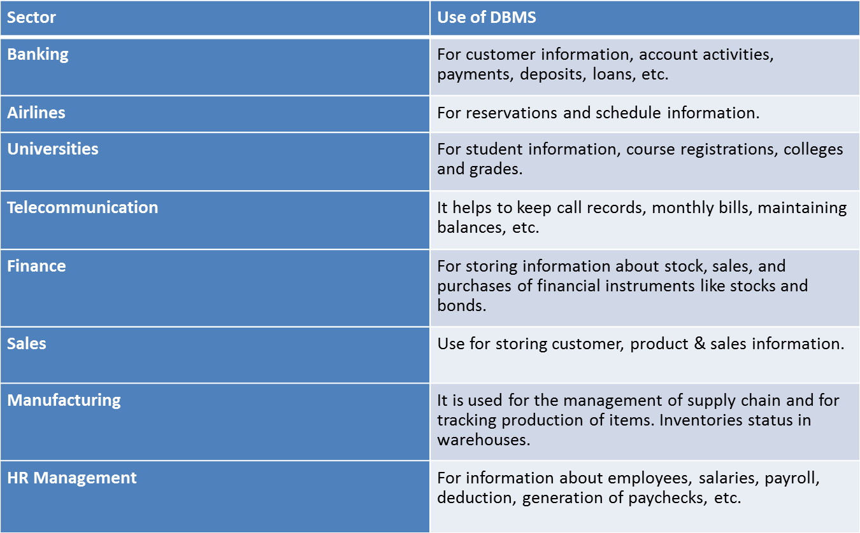
Database Applications
Sector | Use of DBMS
Banking
Airlines
Accounting (School, College, Universities)
Telecommunication
Finance
Sales
Manufacturing
HR Management

Slide 18
Database Applications
Sector | Use of DBMS
Banking | For customer information, account activities, payments, deposits, loans, etc.
Airlines | For reservations and schedule information.
Universities | For student information, course registrations, colleges and grades.
Telecommunication | It helps to keep call records, monthly bills, maintaining balances, etc.
Finance | For storing information about stock, sales, and purchases of financial instruments like stocks and bonds.
Sales | Use for storing customer, product & sales information.
Manufacturing | It is used for the management of supply chain and for tracking production of items. Inventories status in warehouses.
HR Management | For information about employees, salaries, payroll, deduction, generation of paychecks, etc.

Slide 19
Popular DBMS Software
Here, is the list of some popular DBMS system:
MySQL
Microsoft Access
Oracle
PostgreSQL
dBASE
FoxPro
SQLite
IBM DB2
LibreOffice Base
MariaDB
Microsoft SQL Server etc.

Slide 20
https://youtu.be/djEZeF4KTaM

Slide 21
File System
What is File System?
A file system handles the way of reading & writing data to the hard disk.
Machine at home- Folder and store important data and you access it.
Eg. NTFS – New Technology File System is the Windows File System(Which comes in build with OS)
Drawbacks of File System
Data Redundancy & inconsistency
Data Isolation – Data- in different formats & scattered. Difficult to access
No Integrity
No security
Concurrent access anomalies

Slide 22
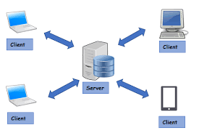
Why DBMS?
Client Server Architecture- Can not use File system
Student info- Admin, exam, department

Slide 23
Advantages of DBMS over File System
No redundant data
removed by data normalization
No data duplication saves storage & improves access time
Data Consistency & Integrity
Data Security – apply access constraints
Privacy – limited access means privacy of data
Easy access to data – keeps backup of data
Easy recovery
Flexible

Slide 24
Disadvantages of DBMS over File System
DBMS implementation cost is high as compared to file system
Complexity – too complex to understand

Slide 25
Database Users
Users may be divided into
use and control the database content
those who design, develop and maintain database.
Those who design and develop the DBMS software and related tools, and the computer systems operators (called “Workers Behind the Scene”).

Slide 26
Database Users
Database administrators:
Responsible for -
authorizing access to the database, for coordinating and monitoring its use,
acquiring software and hardware resources, controlling its use
monitoring efficiency of operations
Database Designers:
Logical Designer- identify data and relationship between them
Physical Designer- How this model can be mapped to physical storage to deliver best performance.

Slide 27
System Analysts:
Develop specifications for application program.
Application programmers:
Implement those specifications
Test, document and maintained db.

Slide 28
Categories of End-users
Actors on the scene
End-users: They use the data for queries, reports and some of them update the database content. End-users can be categorized into:
Casual: not using regularly.
Occasional end user:
Naïve :Constantly querying and updating database
Sophisticated User: Familiar with DBMS

Slide 29
Workers behind scene
1. Tool developers-
Develops tools for database design and graphical interface
2. Operators, Maintenance, System administrator
Run and maintain the hardware and software for data base system.
3. Database designers and Implementers
These people who design and implement dbms modules and interface.

Slide 30
Schemas and Instances
Similar to types and variables of programming languages
Schema
Logical Schema – the overall logical structure of the database
Analogues to type information of a variable in a program
Example: the database consists of information about a set of customers and accounts in a bank and the relationship between them
Customer schema
Account schema
Physical Schema – the overall physical structure of the database
describe how data is to be represented and stored (files, indices, et al.) in secondary storage using a particular database management system
Name | Customer ID | Account# | Aadhaar ID | Mobile#
Account# | Account Type | Interest Rate | Min. Bal. | Balance

Slide 31
Schemas and Instances
Instance
The actual content of the database at a particular point in time
Analogues to the value of a variable
Customer Instance
Account Instance
Name | Customer ID | Account# | Aadhaar ID | Mobile#
sunita | 6728 | 91732 | 123456789034 | 9830100291
sangeeta | 8912 | 82573 | 234567890134 | 7189203928
sushila | 6617 | 37456 | 345678934561 | 8892210189
Account# | Account Type | Interest Rate | Min. Bal. | Balance
91732 | Savings | 4.0% | 5000 | 7812
82573 | Current | 0.0% | 0 | 291800
37456 | Term Deposit | 6.75% | 10000 | 100000

Slide 32
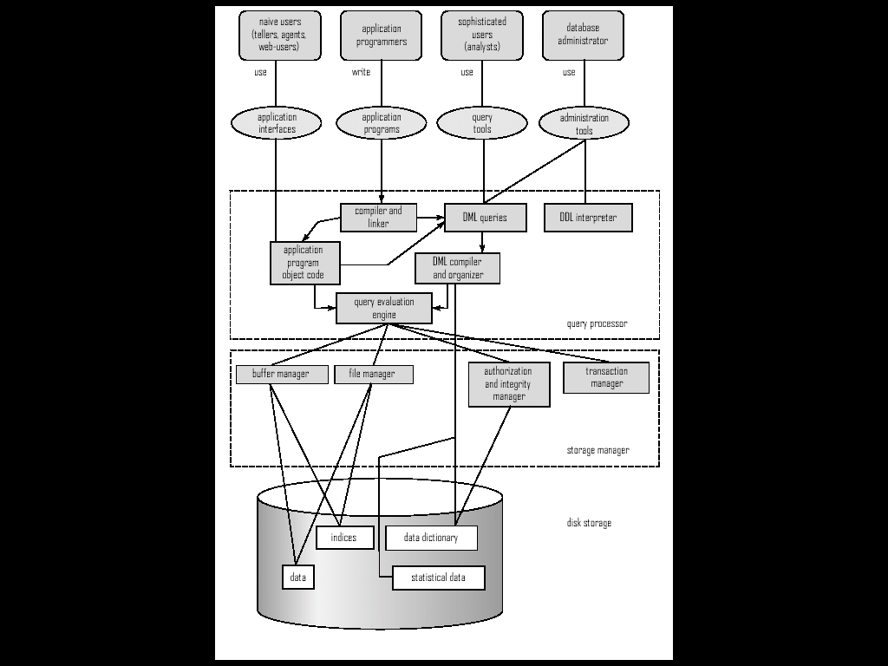
System Architecture

Slide 33
Three-Schema Architecture
Defines DBMS schemas at three levels:
Internal schema at the internal level to describe physical storage structures and access path.
Conceptual schema at the conceptual level to describe the structure and constraints for the whole database for a community of users.
External schemas at the external level to describe the various user views.

Slide 34
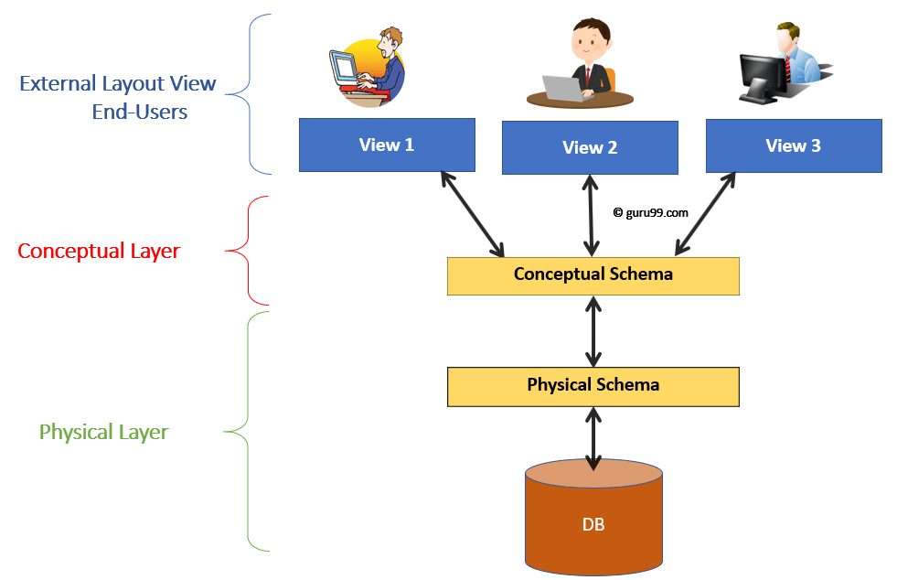
Data Independence
It can be defined as the capacity to change one level of schema without changing the schema at the next higher level.

Slide 35
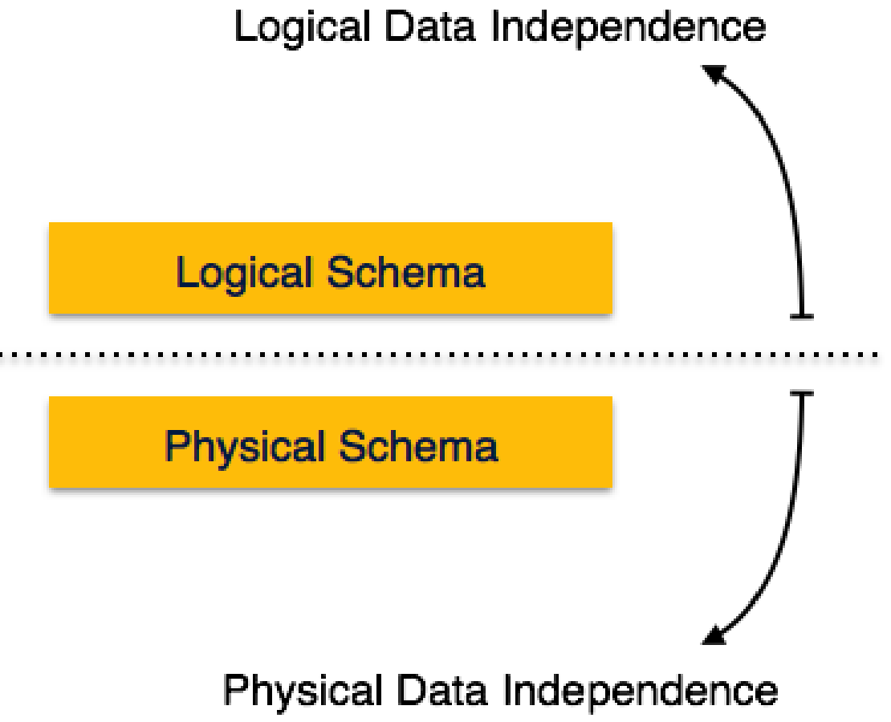

Slide 36
Data Independence
Logical Data Independence:
data about database i.e., it stores information about how data is managed inside
refers to characteristic of being able to change the conceptual schema
Eg. Add/modify/delete attribute, merging of records, breaking existing record into two or more, etc
Thus it allows logical changes to be made to a database without worrying about application program.
Physical Data Independence:
defined as the capacity to change the internal schema
Eg. Using a new storage device like hard drive or magnetic tapes, switching different data structures, etc
Application program need not to know: Order of data field, Size of record, size of each field, format of data item…..

Slide 37
Database Administrator
Database administrator's duties include:
Developing conceptual schema
Deciding which DBMS to use
Defining the database and loading the database content
Assisting and approving applications and access
Deciding data structure
Back up and recovery
Monitoring actual usage

Slide 38
Diagnosing, troubleshooting, resolving –database related problem
Also deals with database security in addition to user identification, authentication, authorization.
https://www.youtube.com/watch?v=ihQhBpgVdyE

Slide 39
Thank you !

